Slide 1
WORLD CUP 2023 ANALYSIS BY KANISHKA GARG

Slide 2
Agenda
Objective
Cleaning of data
Team Performance Analysis
Player Performance Analysis
Opposition and Ground Analysis
Temporal Analysis

Slide 3
Objective
The goal is to uncover patterns, trends, and notable statistics that provide a delicate understanding of team and player performance. The analysis should encompass both batting and bowling aspects, considering key metrics such as runs, wickets, strike rate, economy rate, and other relevant factors.

Slide 4

Cleaning of Data

Slide 5
There are 846 missing values in wickets, overs, maidens and economy rate. These missing values makes sense when that player is batting. There are 562 missing values in 4s, 6s, strike rate, not out and mins. This happens when player is bowling. Hence, I will keep them as NA only as replacing them or removing them will not make any good. When analyzing further, I will just use filter in bat_or_ball column to access batting and bowling metrics.
There are two duplicated rows in the dataset. I removed them and kept one from each of them.
There is one wrong information row in which both teams are Netherland. Hence, I removed that row as it is difficult to guess that which info is wrong and what to change (either team, player or opposition team).
Data type of Start date is changed to date type.

Slide 6
Score Table

Slide 7
Team | Opposite | Date of the match | Inning 1 team runs | Inning 2 opposite runs | Win
ENG | NZ | 2023-10-05 | 282 | 278 | ENG
PAK | NED | 2023-10-06 | 286 | 205 | PAK
SA | SL | 2023-10-07 | 427 | 321 | SA
AFG | BAN | 2023-10-07 | 156 | 155 | AFG
AUS | IND | 2023-10-08 | 193 | 199 | IND
NZ | NED | 2023-10-09 | 319 | 222 | NZ
SL | PAK | 2023-10-10 | 340 | 345 | PAK
ENG | BAN | 2023-10-10 | 361 | 223 | ENG
AFG | IND | 2023-10-11 | 267 | 268 | IND
SA | AUS | 2023-10-12 | 305 | 173 | SA
BAN | NZ | 2023-10-13 | 244 | 247 | NZ
PAK | IND | 2023-10-14 | 188 | 191 | IND
AFG | ENG | 2023-10-15 | 283 | 211 | AFG
SL | AUS | 2023-10-16 | 205 | 215 | AUS
NED | SA | 2023-10-17 | 235 | 205 | NED
NZ | AFG | 2023-10-18 | 284 | 139 | NZ
BAN | IND | 2023-10-19 | 255 | 261 | IND
AUS | PAK | 2023-10-20 | 356 | 297 | AUS
NED | SL | 2023-10-21 | 256 | 250 | NED
SA | ENG | 2023-10-21 | 394 | 161 | SA
NZ | IND | 2023-10-22 | 265 | 273 | IND
PAK | AFG | 2023-10-23 | 278 | 286 | AFG
SA | BAN | 2023-10-24 | 379 | 231 | SA

Slide 8
Team | Opposite | Date of the match | Inning 1 team runs | Inning 2 opposite runs | Win
AUS | NED | 2023-10-25 | 399 | 90 | AUS
ENG | SL | 2023-10-26 | 153 | 160 | SL
PAK | SA | 2023-10-27 | 266 | 265 | PAK
AUS | NZ | 2023-10-28 | 387 | 379 | AUS
NED | BAN | 2023-10-28 | 224 | 142 | NED
IND | ENG | 2023-10-29 | 225 | 127 | IND
SL | AFG | 2023-10-30 | 239 | 241 | AFG
BAN | PAK | 2023-10-31 | 200 | 203 | PAK
SA | NZ | 2023-11-01 | 353 | 162 | SA
IND | SL | 2023-11-02 | 346 | 49 | IND
NED | AFG | 2023-11-03 | 177 | 178 | AFG
NZ | PAK | 2023-11-04 | 393 | 199 | NZ
AUS | ENG | 2023-11-04 | 280 | 247 | AUS
IND | SA | 2023-11-05 | 324 | 83 | IND
SL | BAN | 2023-11-06 | 276 | 269 | SL
AFG | AUS | 2023-11-07 | 286 | 288 | AUS
ENG | NED | 2023-11-08 | 339 | 175 | ENG
SL | NZ | 2023-11-09 | 170 | 172 | NZ
AFG | SA | 2023-11-10 | 239 | 244 | SA
BAN | AUS | 2023-11-11 | 296 | 307 | AUS
ENG | PAK | 2023-11-11 | 330 | 243 | ENG
IND | NED | 2023-11-12 | 409 | 228 | IND
IND | NZ | 2023-11-15 | 395 | 318 | IND
SA | AUS | 2023-11-16 | 208 | 212 | AUS

Slide 9
Winnings Counts Table
India won highest number of matches that is 10. Then comes Australia with 8 wins and South Africa with 6 wins. Then comes New Zealand and Afghanistan with 5 wins each.
India made 409 runs in 1st inning against Netherlands which is the highest than any other team who made this much total runs in a single match.
Team | Number of wins
India | 10
Australia | 8
South Africa | 6
New Zealand | 5
Afghanistan | 5
England | 4
Pakistan | 4
Netherlands | 3
Sri Lanka | 2
Bangladesh | 0

Slide 10
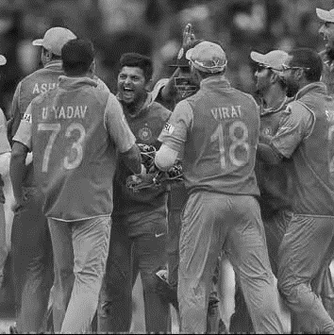
Team Performance Analysis

Slide 11
Top performing teams – India, Australia, South Africa, New Zealand Poor performing teams - Sri Lanka, Pakistan, Netherlands India is the best performer as it tops in the following:
Consistent highest runs made and lowest runs given in a match.
Consistent in giving lowest runs on a ball.
Maximum total fours throughout the tournament along with Australia and New Zealand.
Highest number of not outs in the tournament.
Highest number of wickets taken in the tournament.
Highest maidens in the tournament.
Other top performers and lowest performers are based on either top 4 or
bottom 3 ranks on above parameters.

Slide 12
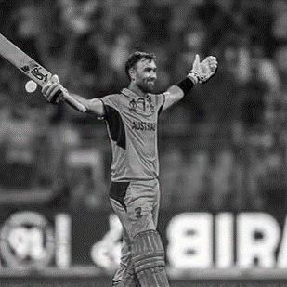
Player Performance Analysis

Slide 13
Top batsman– V Kohli (IND), R G Sharma (IND), Q de Kock (SA), DJ Mitchell (NZ) Important points regarding batting:
GJ Maxwell was the only batsman who scored 201 in a single inning. MR Marsh (AUS) made second highest runs of 177 in a single inning.
V Kohli tops in total runs scored, average runs scored and total 4s.
RG Sharma tops in total 6s.
Shoriful Islam, PJ Cummins and KL Rahul are the three batsman who were not out 4 times each (maximum as compared to others).
Virat Kohli (IND) made maximum total runs of 711 with an average of 71 runs in all matches. His maximum score his 117 and minimum is 0.
Then comes Q de Kock (SA) with second highest total runs of 594 with an average of 174 across all matches. His maximum score is 59 and minimum of 3.
Other top performers are based on top 6 ranks on various parameters.

Slide 14
Top bowlers– JJ Bumrah (IND), Mohammed Shami (IND), Kuldeep Yadav (IND) Important points regarding bowling:
Mohammed Shami who took maximum wickets with consistency too (maximum average).
JR Hazelwood (AUS) gave maximum maidens which is 8, K Rabada and JJ Bumrah with 7 maidens each.
Kuldeep Yadav had a minimum economy rate of 1.35 by giving just 7 runs when he bowled 5.1 overs (31 bowls)
MJ Santber bowled maximum total balls in the tournament with 554 balls bowled and giving 449 runs on it.
In giving least runs on a ball, team India tops the first 5 ranks with R Ashwin having least runs per ball of 0.57.
Other top performers are based on top 6 ranks on various parameters.

Slide 15
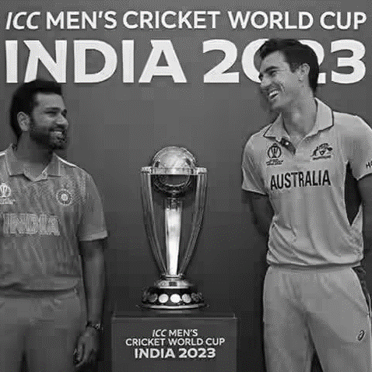
Opposition and Ground Analysis

Slide 16
Opposition Analysis
Team | Good against |  | Bad against
 | Team | At which | Team | At which
Australia | Netherlands | total runs made, 4s and maidens | South Africa | total runs made, maximum runs made, 6s, strike rate, wickets taken and 4s
India | Netherlands | total runs made, maximum runs made, 4s and strike rate | Australia | total runs made, 4s, strike rate and 4s
Pakistan | Sri Lanka | runs made and strike rate | India | runs made and strike rate
England | Netherland | runs made, 6s and strike rate | India | runs made, 4s and strike rate
New Zealand | Pakistan | runs made, 4s and strike rate | South Africa | total runs made, maximum runs made, 4s, 6s and strike rate
Afghanistan | Australia | total runs made, maximum runs made, 6s, maidens and strike rate | New Zealand | total runs made, maximum runs made and 4s
Netherlands | India | total runs made, 6s, maidens and strike rate | Australia | total runs made, maximum runs made, 6s and 4s
Bangladesh | Sri Lanka | Total 4s, strike rate | Netherland | total runs made, maximum runs made, strike rate and economy rate
South Africa | Sri Lanka | total runs made, 4s, wickets and strike rate | Australia | total runs made, maximum runs made, 6s, strike rate, wickets taken and 4s
Sri Lanka | Pakistan | total runs made, maximum runs made, 4s and maidens. | India | total runs made, maximum runs made, 6s, strike rate, wickets taken and 4s

Slide 17
Ground Analysis
Ground | Batting dominance | Bowling dominance
Chennai | Pakistan and New Zealand | India and New Zealand
Lucknow | South Africa and India | South Africa and India
Ahmedabad | New Zealand and Australia | India
Delhi | South Africa and Australia | Australia
Pune | South Africa and England | South Africa and England
Dharamsala | England and Australia | Afghanistan and Netherlands
Eden Garden | England and India | India and Netherlands
Bengaluru | Australia and India | Australia and India
Wankhede | South Africa and India | India and Netherlands
Hyderabad | Sri Lanka | New Zealand

Slide 18
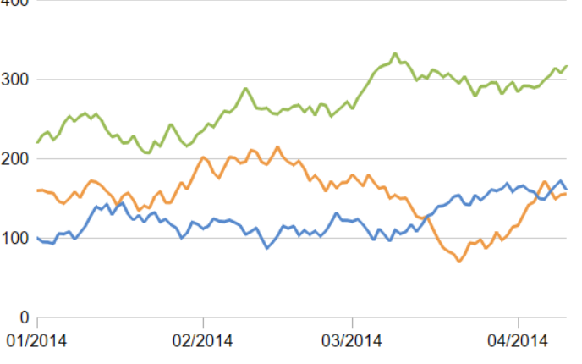
Temporal Analysis

Slide 19
Team | Important events
Australia | Total runs as well boundaries got improved between 16 Oct to 3 Nov. They performed comparatively bad in starting and ending matches. Economy rate is not consistent.
India | Total runs as well boundaries got improved from 14 Oct till end with some fluctuations. They performed comparatively bad in starting match. There is a consistent dip in economy rate from 22 Oct till 6 Nov.
Pakistan | Maximum times Pakistan made runs lower than they faced balls. Economy rate increased at the end of the tournament. Maximum boundaries is on the match 20 Oct.
England | Balls faced and as well as runs made got a dip in middle of the tournament. As a result boundaries are lower in that period. They must be all out before facing all the balls. During their hard time in the middle, economy rate is also very high. It must be pretty clear to them that its not worth trying now with improved balling as their runs were so low.
New Zealand | Out of 10 matches, in 6 matches New Zealand scored runs more than the balls faced by them. In best 2 matches, they also scored higher boundaries. Economy rate is good at the start.

Slide 20
Team | Important events
Afghanistan | In all matches, Afghanistan scored less runs than they faced. Very less boundaries on 18th Oct match. In starting matches, Afghanistan took less wickets.
Netherlands | In all matches, Netherlands scored less runs than they faced. Also, it scored less than 100 in one match in between. Boundaries were also not competitive as compared to other teams throughout the tournament. Economy rate improved in 28 Oct match.
Bangladesh | Except one match, Bangladesh scored less runs than it faced. Also, it scored less than or equal to 150 in two match in between. They improved after the match on 28 Oct. Number of boundaries increased after the match of 28 Oct.
South Africa | Performance of South Africa gradually decreased from the start and then become irregular. Boundaries and runs made follows a similar pattern.
Sri Lanka | In 6 out of 9 matches, Sri Lanka scored less runs than it faced balls. On 2 Nov match, it scored less than 50 runs as well as lowest boundaries. Performance of Sri Lanka gradually decreased from the start.

Slide 21
Thank you

